Slide 1




Welcome!
This presentation is about the importance of tourism to Seychelles
We hope that you will enjoy it.

Slide 2
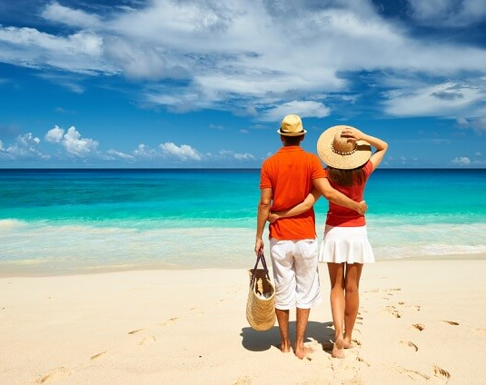
WHY IS TOURISM SO IMPORTANT TO SEYCHELLES?
AND WHY IS SEYCHELLES SO LOVED BY TOURISTS?

Slide 3
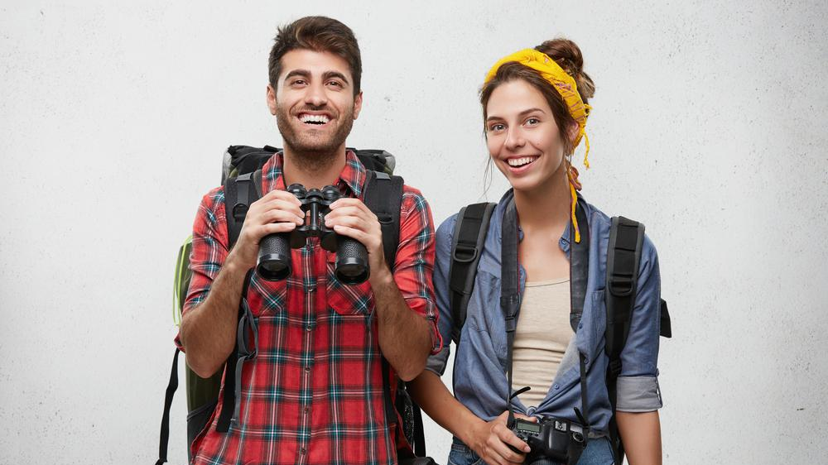
MEET
KLAUS & MARIE HOFNER
They are two tourists visiting Seychelles after being ‘locked down’ in Europe. They are rewarding themselves with a dream holiday.

Slide 4
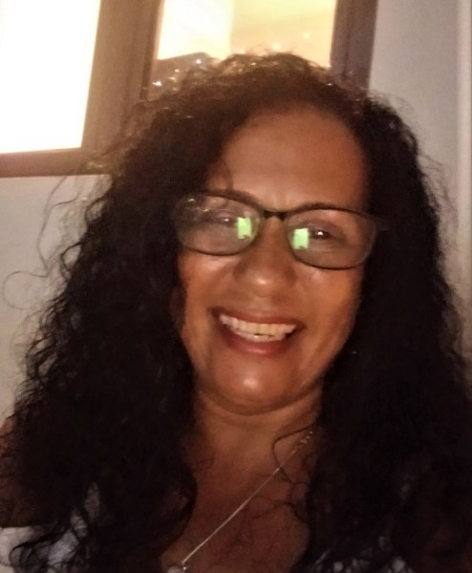
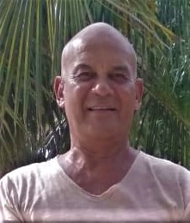
MEET
David Hoffman & Francine Gappy
This Seychellois couple run Hyde–Tide Apartments, a tourism establishment on La Digue

Slide 5
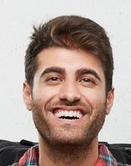
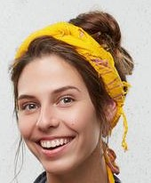
TWO COUPLES WHO NEED EACH OTHER

Slide 6
WHY?
KLAUS AND MARIE want to spend ten days on LA DIGUE but they prefer to stay in a small, friendly, family-run business rather than a large hotel.
DAVID AND FRANCINE have just the kind of property that Klaus and Marie are looking for – quiet and cosy. They call it ‘HYDE-TIDE’. The rooms are all air-conditioned, with TV and a sea view.
KLAUS AND MARIE found out about HYDE-TIDE on the internet. It looks wonderful and they have made a booking. Also it is within their budget so they can afford to stay there.

Slide 7
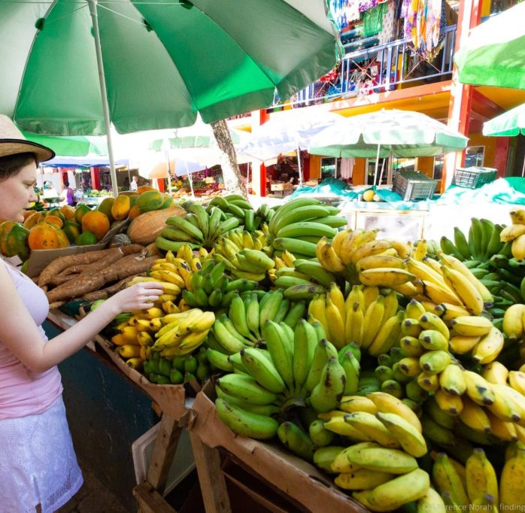
Tourists enjoy experiencing the REAL Seychelles, including Creole food. David and Francine can advise Klaus & Marie on authentic Creole cuisine.

Slide 8
HOW DO THE TWO COUPLES BENEFIT FROM EACH OTHER?
KLAUS AND MARIE live and work in GERMANY, where they are paid in EUROS. Whilst staying on La Digue they will exchange their EUROS to get spending money in SEYCHELLES RUPEES. They will also pay for their room and meals in EUROS.
Seychelles needs EUROS, DOLLARS, POUNDS AND OTHER FOREIGN EXCHANGE in order to pay for IMPORTS. These are the things that we need and which we get from overseas.
Many of the things in your school and your home are IMPORTED, as well as 80% of the food that we eat. All cars, lorries, buses etc are imported. All of this has to be paid for with foreign currency, most of which comes from TOURISTS like KLAUS AND MARIE.

Slide 9
So we can begin to understand why tourism is so important to everyone in Seychelles
We don’t manufacture or make very many things in Seychelles
But we still need them, so we have to buy them from other countries which do make them, for example we might buy furniture from India which we pay for in Indian Rupees. We get Indian Rupees by EXCHANGING Seychelles Rupees.
Some days foreign currency costs more Seychelles Rupees than others.
Today 100 Indian Rupees would cost 27 Seychelles Rupees, but this might change tomorrow.

Slide 10
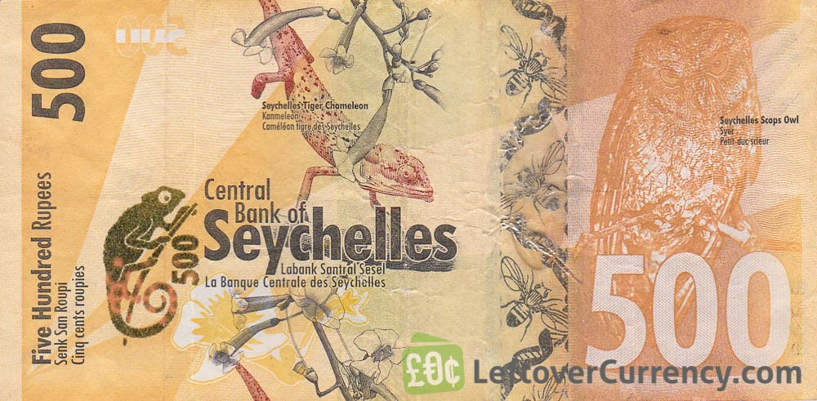
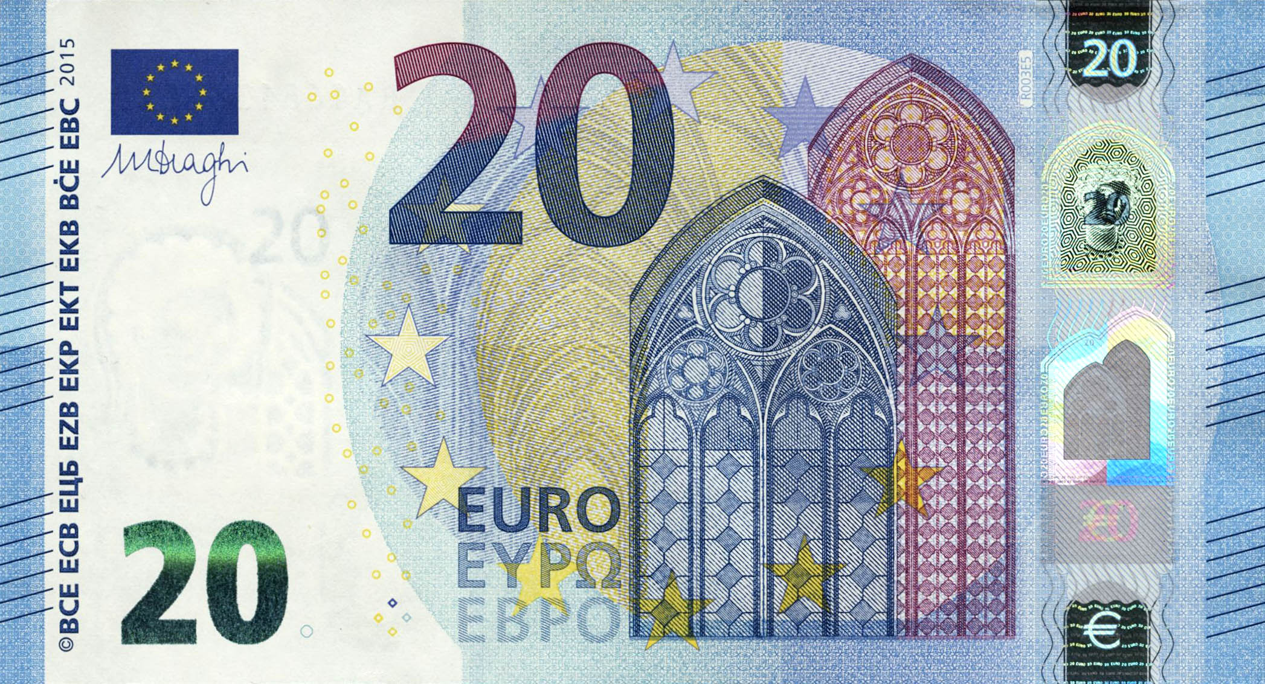

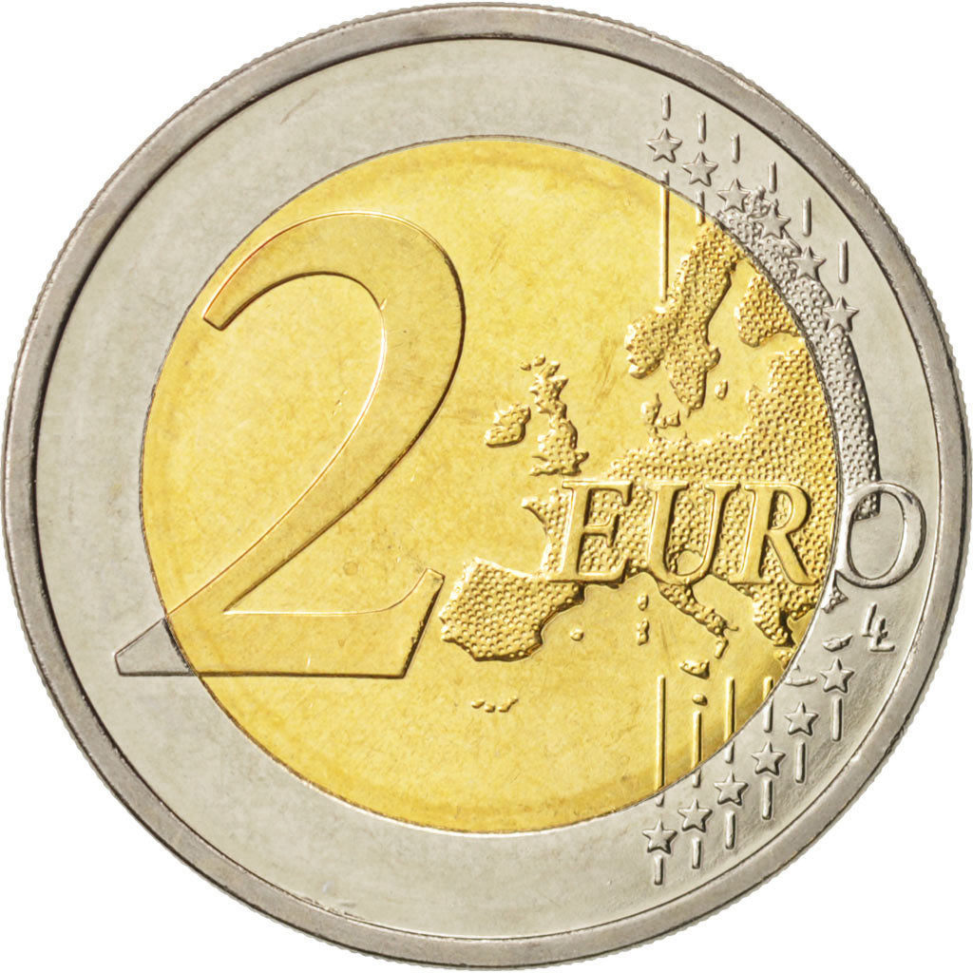
Mostly however Seychelles receives EUROS from tourists because most of them come from EUROPE.
Today, we would exchange SR500 for just over 22 Euros

Slide 11

But that’s not much!?
True. One year ago we would have got more than 30 Euros. That’s almost 10 more!
WHAT HAPPENED?
COVID – 19 has badly hit our ECONOMY. This is a word we use to describe the making and trading (buying and selling) of things of value – goods (objects) and services.
In Seychelles we rely on TOURISM for most (about 70%) of our INCOME.
Because of COVID - 19 we have not had many tourists, in fact for months we had NONE. This has led to Seychelles Rupees being worth LESS than before.

Slide 12
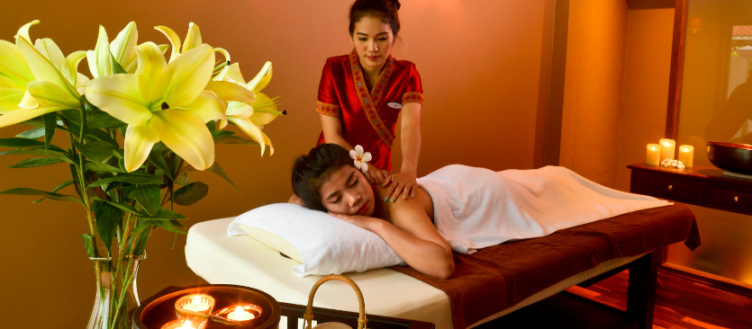
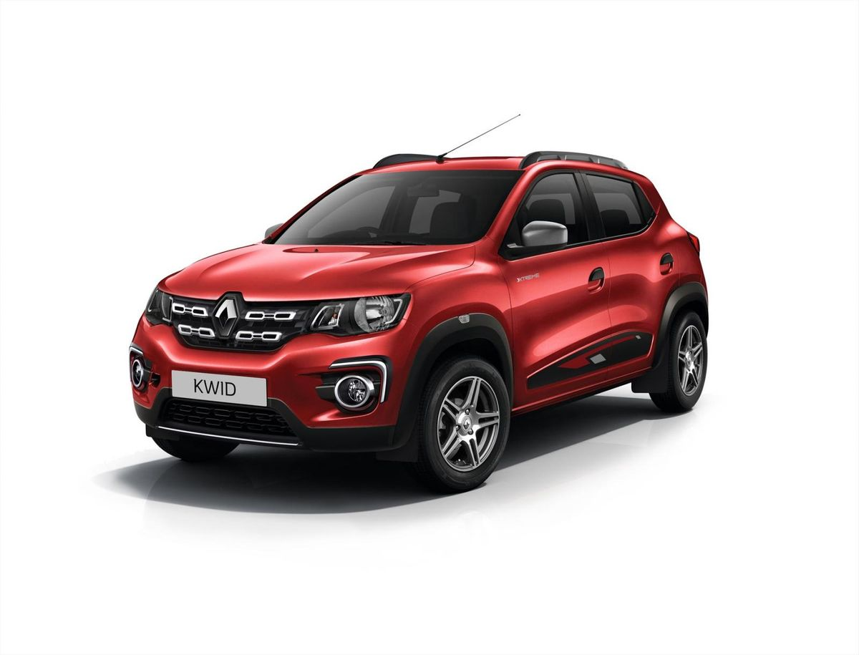
‘Goods’ and ‘Services’? What’s the difference?
‘Goods’ are things which have a physical form, for example a car
‘Services’ describes an action of helping or doing something for someone. A massage would be an example.

Slide 13
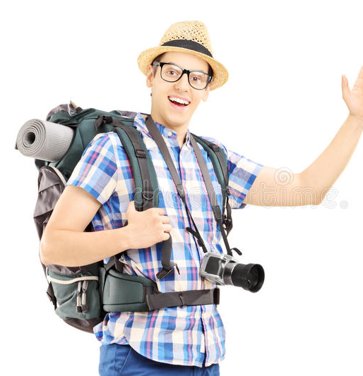
So what can we do!?
WE CAN WELCOME BACK PEOPLE LIKE THIS GUY…
WE CAN MAKE SURE THAT HE HAS A GREAT HOLIDAY
HE WILL POST GOOD THINGS ABOUT SEYCHELLES ON SOCIAL MEDIA
HE WILL TELL HIS FRIENDS ABOUT THE WONDERFUL TIME HE HAD IN SEYCHELLES
OTHER PEOPLE WILL READ WHAT HE WRITES, LISTEN TO WHAT HE SAYS AND THEN SOME OF THEM WILL SAY…..
“HEY! I WANT TO GO TO SEYCHELLES TOO!”

Slide 14
But if we don’t make much how can we pay for the things we need from other countries?
We don’t make things, but we do create happiness.
So when tourists visit Seychelles they are buying experiences and a wonderful holiday. They might buy some souvenirs but mostly they will buy SERVICES.
As we know, services include things like a boat trip, underwater dives and a massage. Afterwards tourists take away memories and good feelings rather than objects.
So, put simply our ECONOMY sees experiences being exchanged for things.

Slide 15
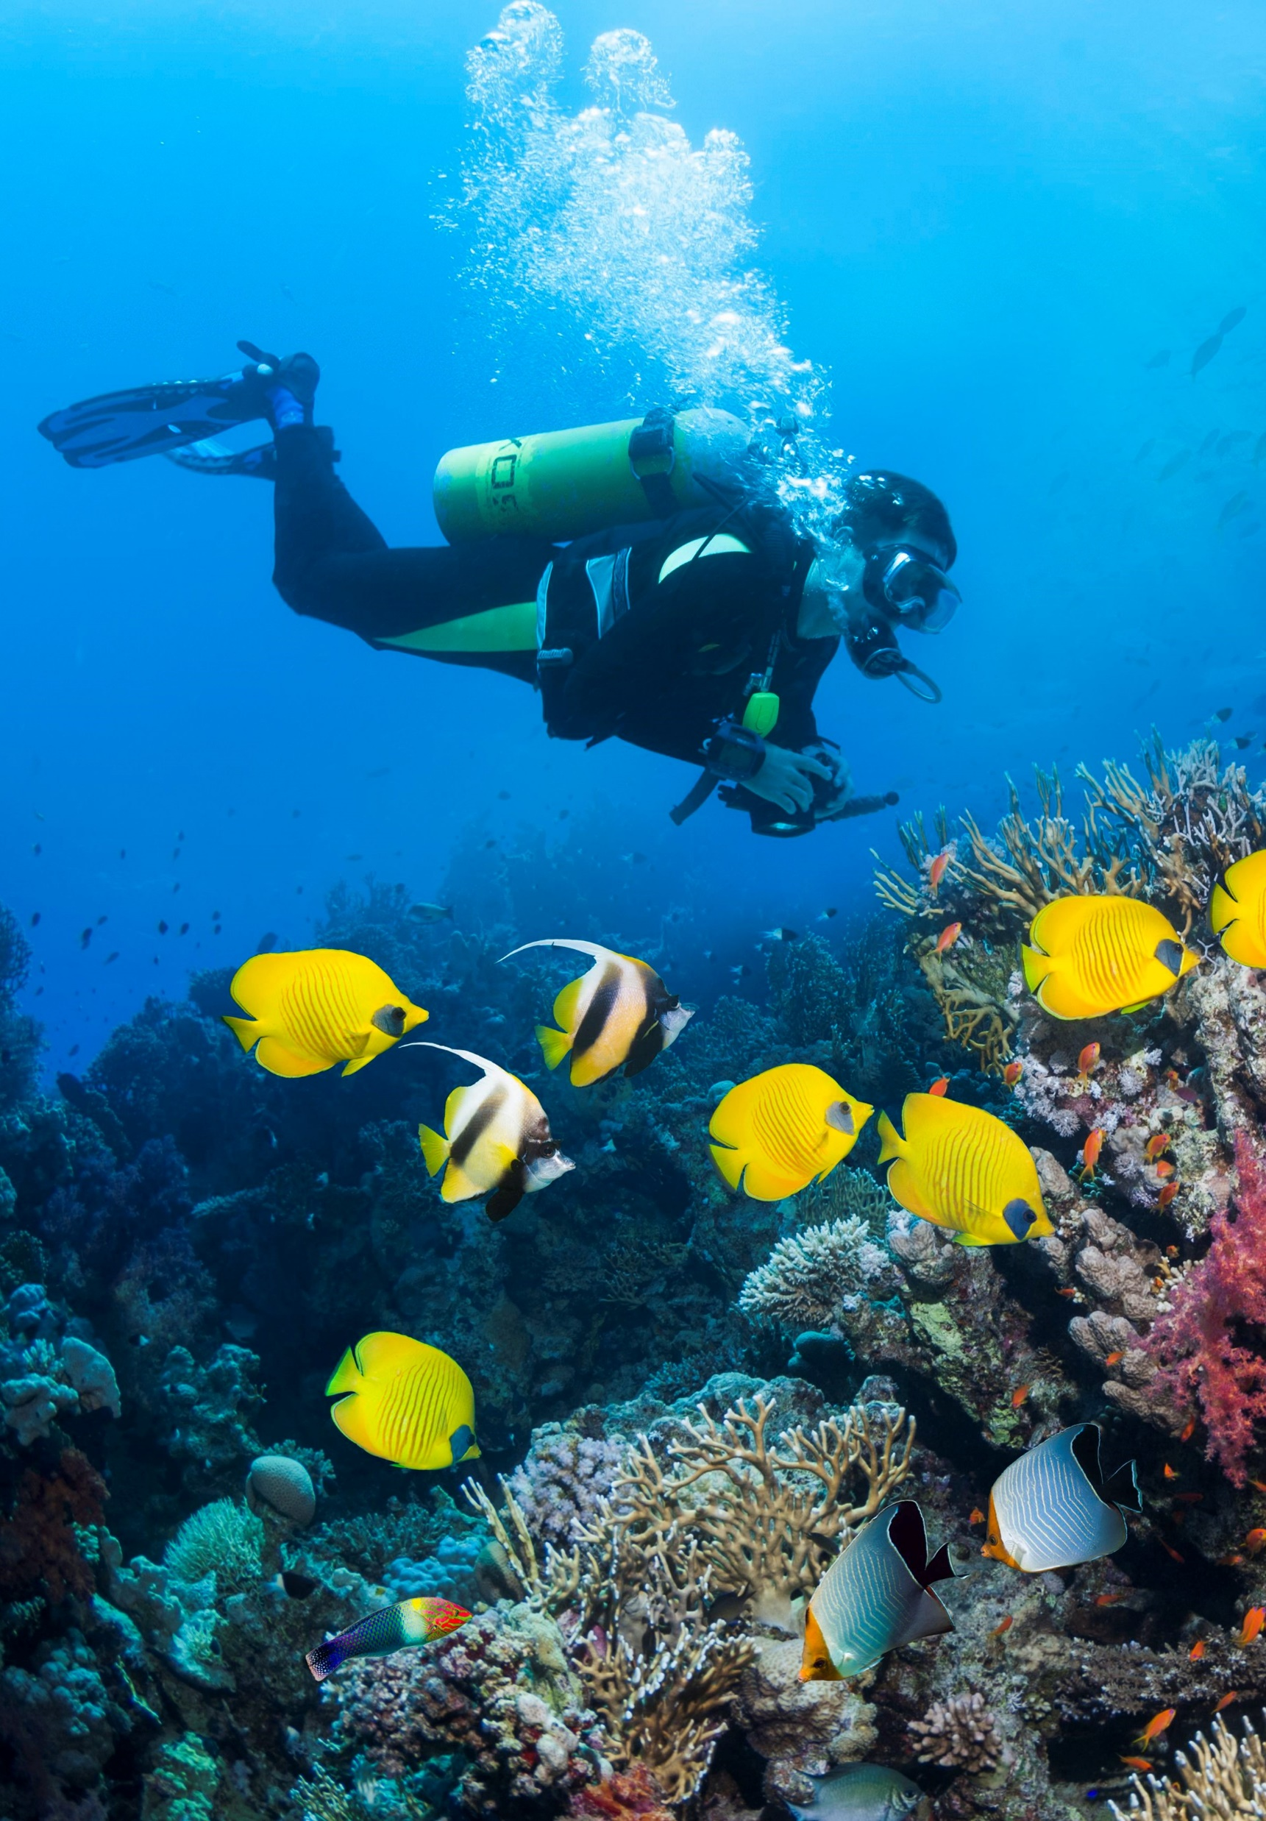
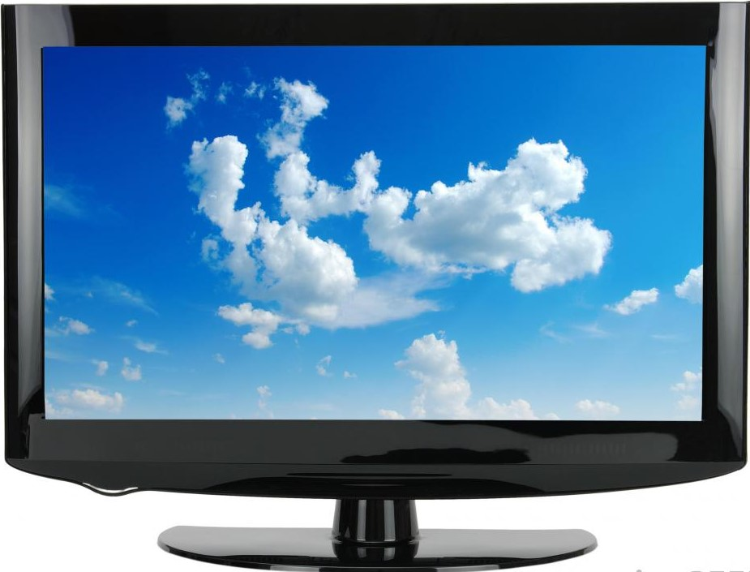
The Euros paid for a diving course in Seychelles can be used to buy a television set from Dubai…..

Slide 16
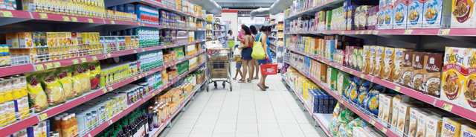
And, more important - the Euros paid for the diving course can be used to buy the food we need but which we do not produce ourselves

Slide 17

Everything was going pretty well….and then 2020 came along……
THE COVID-19 VIRUS WHICH BEGAN TO AFFECT THE WORLD IN LATE JANUARY 2020, HAS HAD A VERY BAD EFFECT ON TOURISM EVERYWHERE
The loss to the world’s economy is estimated at 1 TRILLION dollars, which is $1,000,000,000,000, a very hard number to understand and imagine….so let’s make it simpler…

Slide 18
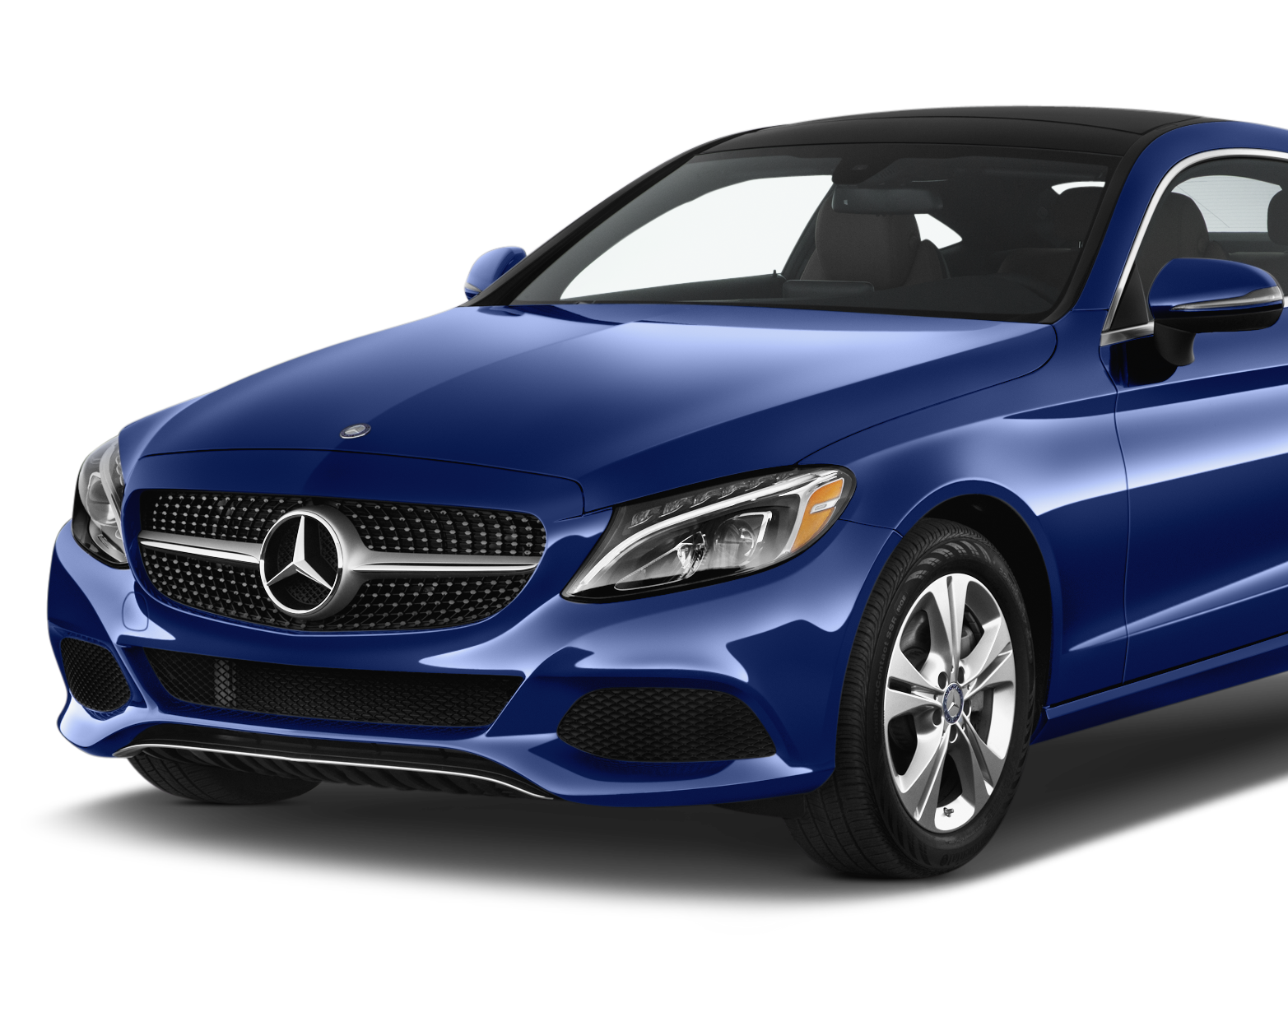
Earlier we talked about ‘goods’ and ‘services’
If we add together the value of ALL of the goods and services in Seychelles for the last ‘normal’ year we get $1.6 BILLION, that’s $1,600,000,000! A lot of money!
Now, the worldwide loss of tourism business, which is 1 TRILLION dollars, equals 625 years of all business in Seychelles.
Put another way, the loss of 1 TRILLION dollars is the same as the cost of more than 24 MILLION Mercedes Benz cars, enough for every man woman and child in Seychelles to have almost 300 of these cars EACH!

Slide 19
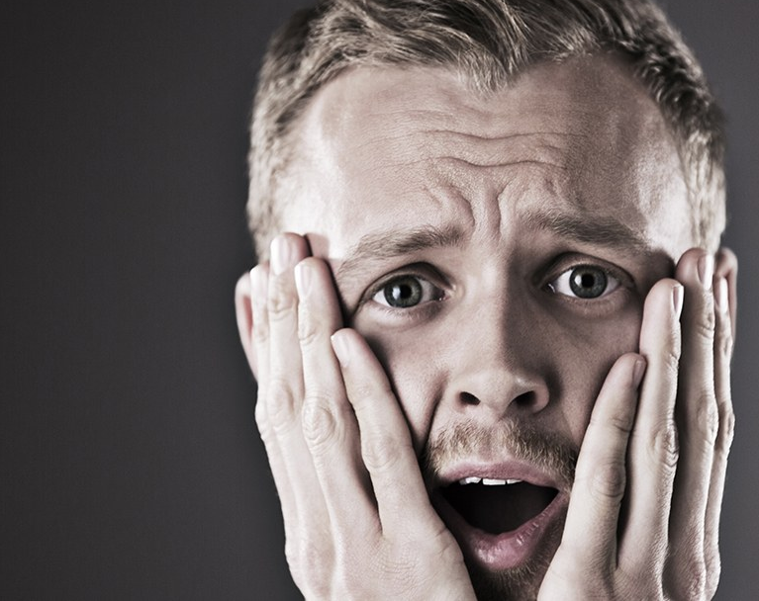
Why do we need to know this?
Because the loss of most of our tourism in 2020 means that Seychelles has earned much less money than it needs.
Because although many other countries have also suffered from the loss of tourism not many of them are as DEPENDENT on tourism as we are in Seychelles.
So the very bad effect of COVID-19 on tourism is felt more here in Seychelles than in most other countries because we rely on tourism for most of our money. This money is needed to pay for the things we need from other countries.

Slide 20
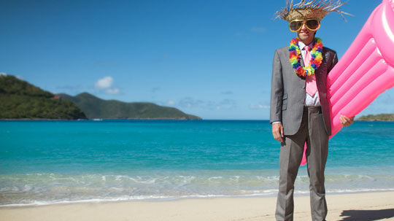
But HEY! Cheer Up!!!
It’s true. At the moment things are very tough. But nothing lasts forever, and scientists believe that COVID-19 will be CONTROLLED in the near future. The trouble is that NO ONE knows exactly when…
When this happens tourists will begin to return to Seychelles in larger numbers.
Here are some of the reasons why….

Slide 21
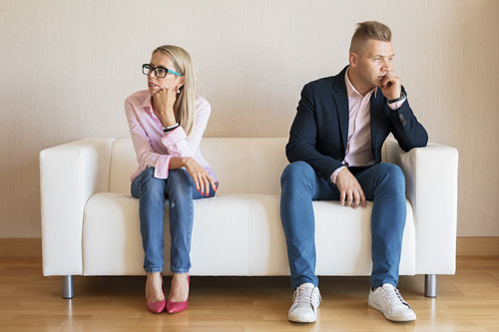
“We’ve been locked down for many weeks, working from home and not really able to go out or see our friends…
…….WE NEED A HOLIDAY!”

Slide 22
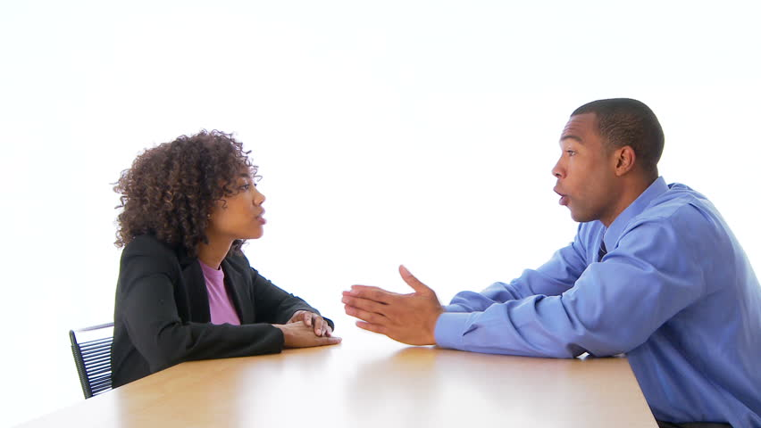
“We’ve always wanted to visit the Seychelles, so let’s reward ourselves and go NOW!”

Slide 23
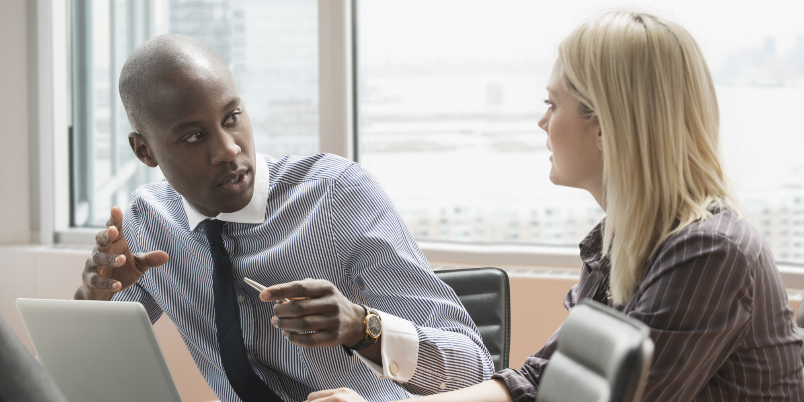
“Everyone says that Seychelles is incredibly BEAUTIFUL, that the people there are really FRIENDLY, and remember, during COVID it was one of the SAFEST places on the planet….”

Slide 24
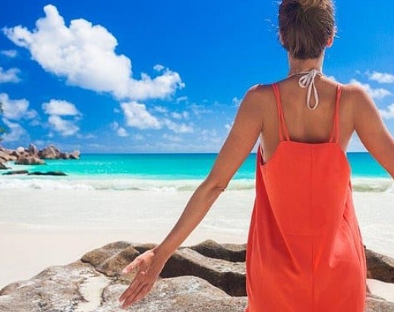
So…….when more tourists return to Seychelles we all need to make them feel especially WELCOME!

Slide 25

….and finally….
Your teacher will give you some activities to do which are about some of the things you have learned from this slide show.

